Slide 1
Language Modelling for Text Prediction
Devan Kuleindiren

Slide 2
Do you want to grab a

Slide 3
drink
coffee
bite
spot
0.327
0.211
0.190
0.084
Do you want to grab a
. . .
. . .

Slide 4
N-gram

Slide 5
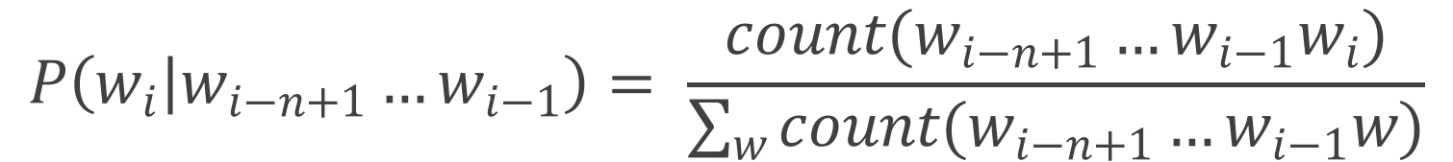
N-gram
$$P\left(w_{i} | w_{i−n+1}…w_{i−1}\right)= \frac{count(w_{i−n+1}…w_{i−1}w_{i})}{\sum_{w}{count(w_{i−n+1}…w_{i−1}w)}}$$

Slide 6
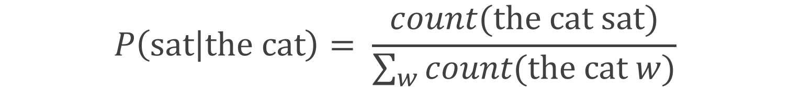
N-gram
$$P\left(sat | the cat\right)= \frac{count(the cat sat)}{\sum_{w}{count(the cat w)}}$$

Slide 7

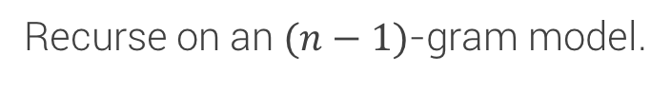
N-gram
$$P\left(sat | the cat\right)= \frac{count(the cat sat)}{\sum_{w}{count(the cat w)}}$$
Backoff
$$P\left(sat | the cat\right)$$
Recurse on an $(n−1)$-gram model.

Slide 8
N-gram
$$P\left(sat | the cat\right)= \frac{count(the cat sat)}{\sum_{w}{count(the cat w)}}$$
Backoff
Smoothing
$$P\left(sat | the cat\right)$$
Some methods:
Absolute discounting
Kneser-Ney
Modified Kneser-Ney
Recurse on an $(n−1)$-gram model.
Add one
Katz

Slide 9
Neural Networks
Output:
y₁
y₂
y₃
y_{m}
…
…
…
…
Input:
x₁
x₂
x₃
x_{n}

Slide 10
Neural Networks
Output:
y
Input:
x

Slide 11
Recurrent Neural Networks
Output:
y
Input:
x

Slide 12
Recurrent Neural Networks
Output:
y1
y2
y3
…
Input:
x1
x2
x3

Slide 13
Recurrent Neural Networks
Output:
the
cat
sat
…
Input:
<s>
the
cat

Slide 14
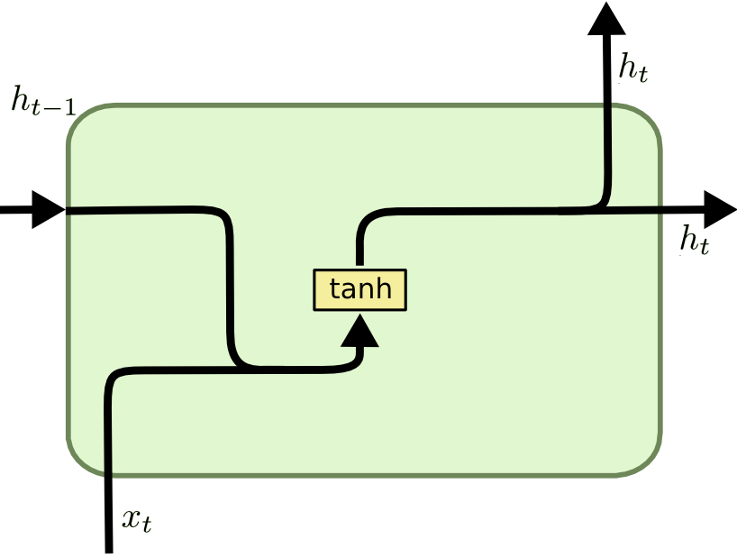
Recurrent Neural Networks
Output:
the
cat
sat
Vanilla RNN
…
Input:
<s>
the
cat

Slide 15
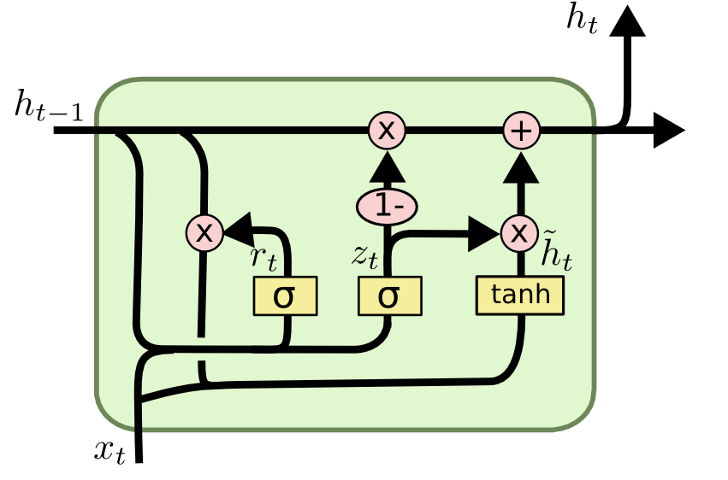
Recurrent Neural Networks
Output:
the
cat
sat
Gated Recurrent Unit (GRU)
…
Input:
<s>
the
cat

Slide 16
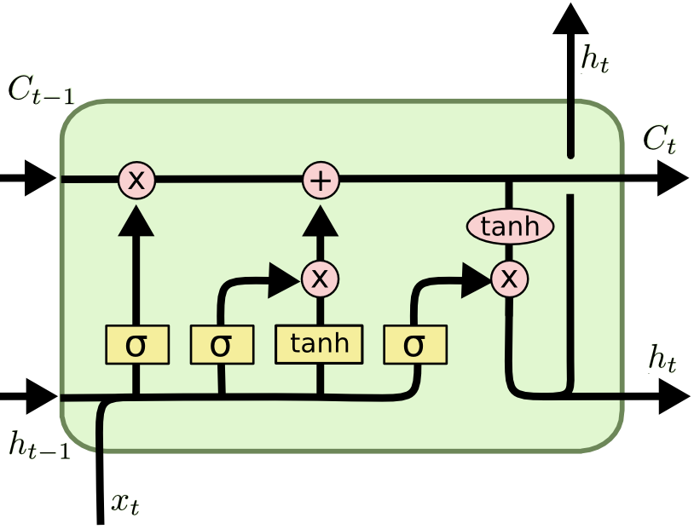
Recurrent Neural Networks
Output:
the
cat
sat
Long Short-Term Memory (LSTM)
…
Input:
<s>
the
cat

Slide 17
What have I built?

Slide 18
Progress
N-gram
+ Add one
+ Katz
+ Absolute discounting
+ Kneser-Ney
+ Modified Kneser-Ney

Slide 19
Progress
N-gram
RNN
+ Add one
+ Katz
+ Absolute discounting
+ Kneser-Ney
+ Modified Kneser-Ney
Vanilla RNN
Gated Recurrent Unit
Long Short-Term Memory

Slide 20
Progress
N-gram
RNN
+ Add one
+ Katz
+ Absolute discounting
+ Kneser-Ney
+ Modified Kneser-Ney
Vanilla RNN
Gated Recurrent Unit
Long Short-Term Memory
Benchmark
Perplexity
Average keys saved
Guessing entropy
Physical memory usage
Prediction speed

Slide 21
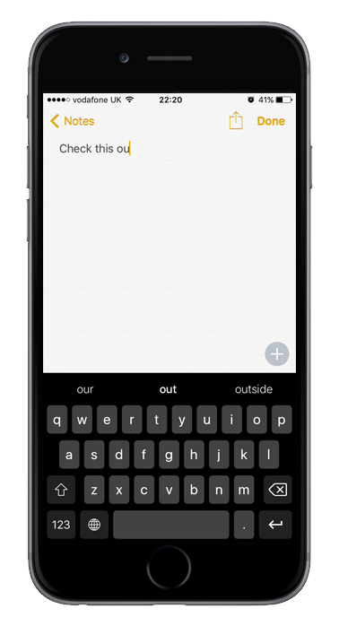
Progress
N-gram
RNN
+ Add one
+ Katz
+ Absolute discounting
+ Kneser-Ney
+ Modified Kneser-Ney
Vanilla RNN
Gated Recurrent Unit
Long Short-Term Memory
Benchmark
Perplexity
Average keys saved
Guessing entropy
Physical memory usage
Prediction speed

Slide 22
What’s left?

Slide 23
What’s Left
The weather is nice

Slide 24
What’s Left
The whether is ____

Slide 25
3-gram + Kneser-Ney
it isn't the only way to get a piece of the company 's stock exchange composite trading on the new york stock exchange composite trading on the …
LSTM
it is a way to get out of the company 's new strategy.

Slide 26
3-gram + Kneser-Ney
the meaning of life is threatened to veto the bill.
LSTM
the meaning of life is that the new york times isn't the only way to be the first time to be a major part of the problem.

Slide 27
Thanks for listening!

